Slide 1
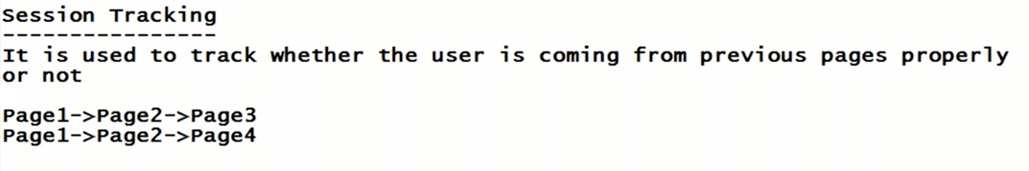
Example :
Gmail application
Login screen (page1)
Inbox(page2)
Assume Some copied URL of page2
It redirects to home page

Slide 2
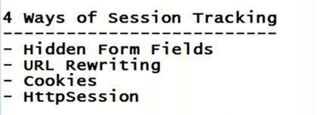

Slide 3
(Previous page)

Slide 4
In page 1 we create one hidden filed which is not visible to user , then when we connect from page 1 to page 2.
In page 2 we read the value of hidden field
So in page 2 if you are able to read the value of hidden field indicates that you are coming from page 1.
If you are not coming from page1 if you open page 2 directly , then can you able to read the value of hidden filed ? NO ,So we can say invalid session if some one access page 2 directly

Slide 5
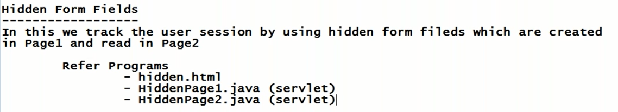
Refer HiddenFormFields.war

Slide 6
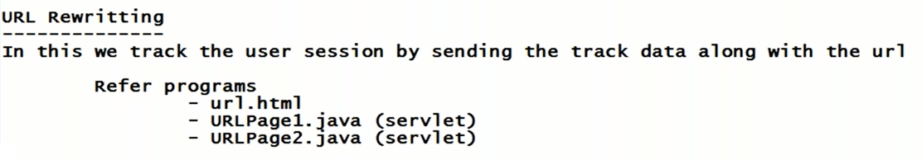
Refer UrlRewriting.war

Slide 7
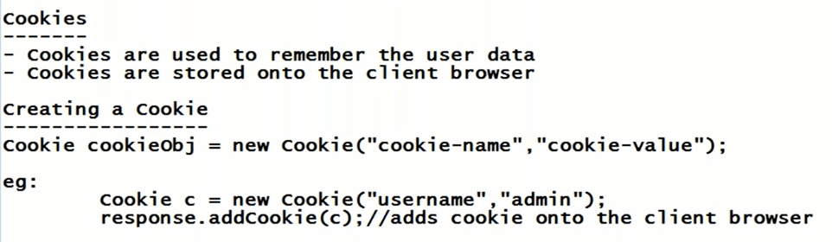

Slide 8
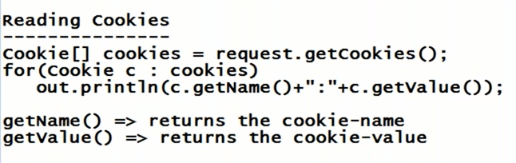
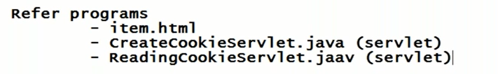
Refer CookiesEx2.war

Slide 9
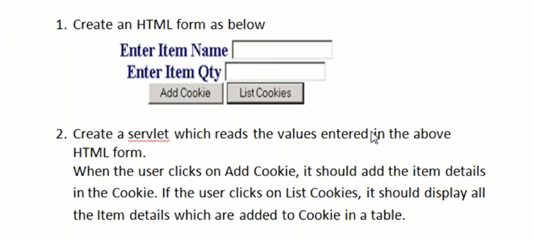

Slide 10
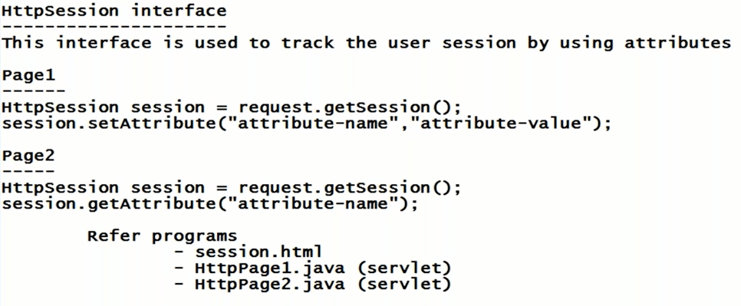
Refer HttpSessionEx2.war

Slide 12
What is Session Tracking?
When a user interacts with a web application, a "session" is created to remember their activities during their visit. HTTP, the protocol used for communication between a web browser and a server, is stateless. This means that the server does not automatically remember the previous requests from the same user.
Session Tracking is the technique used to maintain the state of a user across multiple requests (pages) in a web application.

Slide 13
Why is Session Tracking Important?
Imagine you're logged into an online store and add items to your shopping cart. When you go to a different page (like the checkout), the store should remember the items you added. Session tracking ensures that the user's actions are preserved across different pages.
Different Ways to Track a Session in Java:
There are four primary techniques for session tracking in Java:
Cookies
URL Rewriting
Hidden Form Fields
HttpSession

Slide 14
1. Cookies:
What are Cookies? Cookies are small pieces of information stored on the client-side (browser). They allow servers to store user-related information and track users across multiple HTTP requests.
How Cookies Work in Session Tracking:
When the user makes a request to the server, the server can send a Set-Cookie header in the response.
The browser will store this cookie and send it back to the server with every subsequent request to the same domain.

Slide 15
import javax.servlet.*;
import javax.servlet.http.*;
import java.io.*;
public class CookieExample extends HttpServlet {
protected void doGet(HttpServletRequest request, HttpServletResponse response) throws ServletException, IOException {
// Create a cookie to track session
Cookie cookie = new Cookie("user", "bjln");
cookie.setMaxAge(60*60); // Cookie valid for 1 hour
response.addCookie(cookie);
// Display a response to the user
response.setContentType("text/html");
PrintWriter out = response.getWriter();
out.println("Cookie set with the name 'user' and value 'JohnDoe'.");
}
}

Slide 16
Pros:
1. Cookies are easy to implement.
2. They allow servers to store small amounts of data.
Cons:
1. Cookies are stored on the client side, so they can be tampered with or blocked.
2. Browsers have a limit on the size and number of cookies.

Slide 17
2. URL Rewriting:
What is URL Rewriting?
In URL rewriting, the server appends session information (a unique session ID) to the URL. This ensures the server can recognize the user in subsequent requests.
How URL Rewriting Works:
The server generates a session ID and attaches it to each URL that the user clicks.
Every time the user requests a new page, the session ID is passed along with the request.

Slide 18
import javax.servlet.*;
import javax.servlet.http.*;
import java.io.*;
public class URLRewritingExample extends HttpServlet {
protected void doGet(HttpServletRequest request, HttpServletResponse response) throws ServletException, IOException {
response.setContentType("text/html");
PrintWriter out = response.getWriter();
// Get session and assign an attribute
HttpSession session = request.getSession();
session.setAttribute("user", "bjln");
// Get the session ID
String url = response.encodeURL("nextPage"); // URL Rewriting
out.println("Click <a href='" + url + "'>here</a> to visit the next page.");
}
}

Slide 19
Pros:
Works even if cookies are disabled in the browser.
Cons:
1.The session ID is visible in the URL, which may expose it to security risks.
2.The URL length may increase, making URLs look messy.

Slide 20
3. Hidden Form Fields:
What are Hidden Form Fields?
Hidden form fields are invisible fields in an HTML form that store session information. This data is submitted whenever the form is submitted.
How Hidden Form Fields Work:
The server generates a session ID and stores it in a hidden field within an HTML form.
Every time the form is submitted, the session information is sent to the server.

Slide 21
import javax.servlet.*;
import javax.servlet.http.*;
import java.io.*;
public class HiddenFieldExample extends HttpServlet {
protected void doGet(HttpServletRequest request, HttpServletResponse response) throws ServletException, IOException {
response.setContentType("text/html");
PrintWriter out = response.getWriter();
// Hidden field in HTML form
out.println("<form action='nextPage' method='post'>");
out.println("<input type='hidden' name='sessionID' value='123456'>");
out.println("<input type='submit' value='Submit'>");
out.println("</form>");
}
}

Slide 22
Pros:
Works with browsers where cookies are disabled.
Cons:
1. Only works when forms are submitted.
2. Limited to form submissions, so not suitable for tracking across non-form pages.

Slide 23
4. HttpSession (Most Common Method):
What is HttpSession?
The HttpSession interface allows web applications to create a session for each user and store information on the server.
How HttpSession Works:
The server creates an object of HttpSession when a user first interacts with the application.
This session object can store any user-specific information, such as username, cart items, etc.
Each user has a unique session ID that can be tracked automatically (usually through cookies).

Slide 24
import javax.servlet.*;
import javax.servlet.http.*;
import java.io.*;
public class HttpSessionExample extends HttpServlet {
protected void doGet(HttpServletRequest request, HttpServletResponse response) throws ServletException, IOException {
response.setContentType("text/html");
PrintWriter out = response.getWriter();
// Creating a session or retrieving an existing one
HttpSession session = request.getSession();
// Store data in the session
session.setAttribute("username", "bjln");
out.println("Session created. Username stored in session.");
}
}

Slide 25
Pros:
1. Convenient to store large amounts of data.
2. Information is stored on the server, so it is more secure than cookies.
Cons:
Requires more server memory as data is stored on the server.
2. Can lead to session timeout issues if not managed properly.

Slide 26
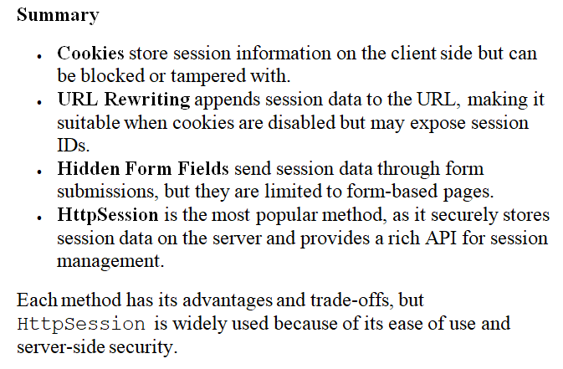

Slide 27
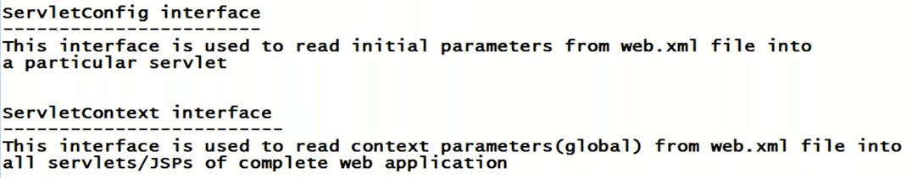
Refer ServletConfigProject.war

